Slide 1


KNN/Patient Like Me Update
Simon Lee
July 9, 2024

Slide 2
Motivation
We developed Pseudo-notes which is an interpretable readout of tabular EHR datasets. It also creates an interface to interact with pre-trained Language Models and Large Language Models
Pseudo-notes also addresses issues regarding the data covering several biological and time scales which is hard to account for and synergize.

Slide 3
Our Project Motives
Patient Like Me
Can we provide an XAI (explainable AI algorithm) that can find “patients like me” to inform evidence-based decision making at a case-by-case level
Early Proposal:
Construct a KNN on LLM embeddings of our pseudo-notes
(Interpretable readouts of our data + Interpretable decision making)
We replicate the ED Disposition task from our MEME paper
TODO: Potentially include Claims datasets which could also inform decisions outside of inpatient data

Slide 4
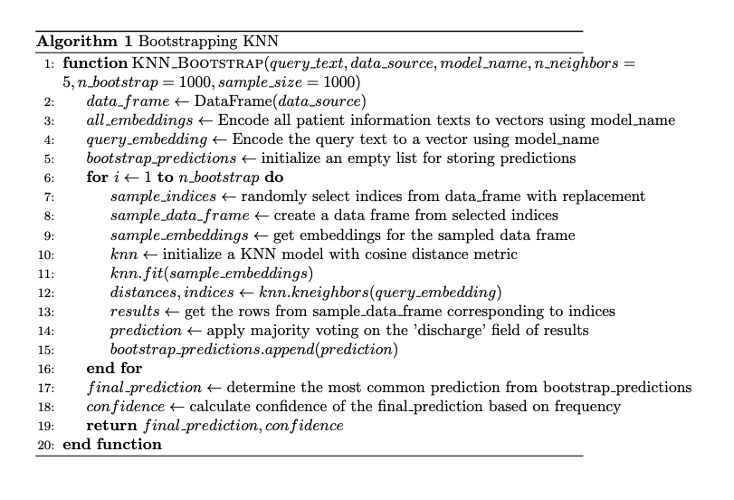
My Update
Designed 2 KNN Algorithms
Bootstrapping KNN algorithm: This provides a memory efficient solution and potentially robust model for generating prediction if we cannot fit all embeddings in the KNN

Slide 5
My Update
Designed 2 KNN Algorithms
Bootstrapping KNN algorithm: This provides a memory efficient solution and potentially robust model for generating prediction if we cannot fit all embeddings in the KNN

Slide 6
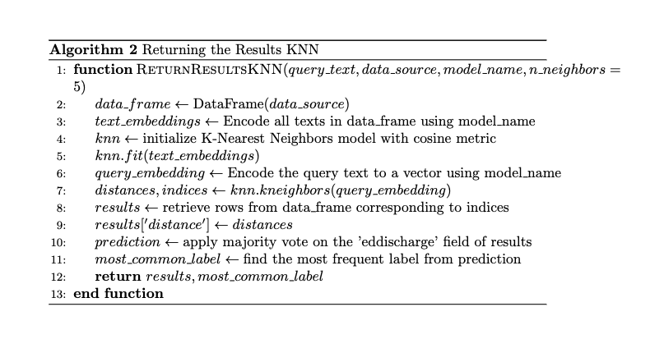
My Update
Designed 2 KNN Algorithms
2. Evidence Based KNN: Returns a list of patient ID’s, “decisions”, distance, where clinicians can further inspect the nearest neighbors. Very similar design minus bootstrapping. Assumption is that we have enough compute to store these embeddings.

Slide 7
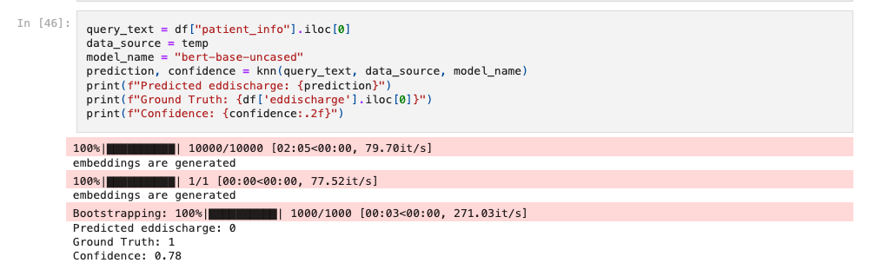
Results 1: KNN Boostrapping method
Just as a sanity check. I tried a base bert model versus a clinical bert model
10k
1k

Slide 8
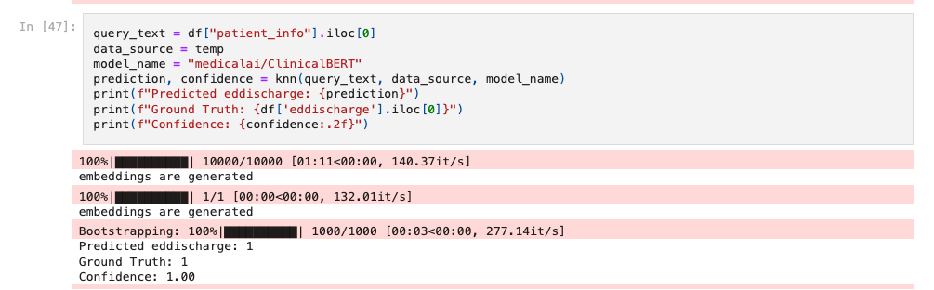
Results
Just as a sanity check. I tried a base bert model versus a clinical bert model

Slide 9
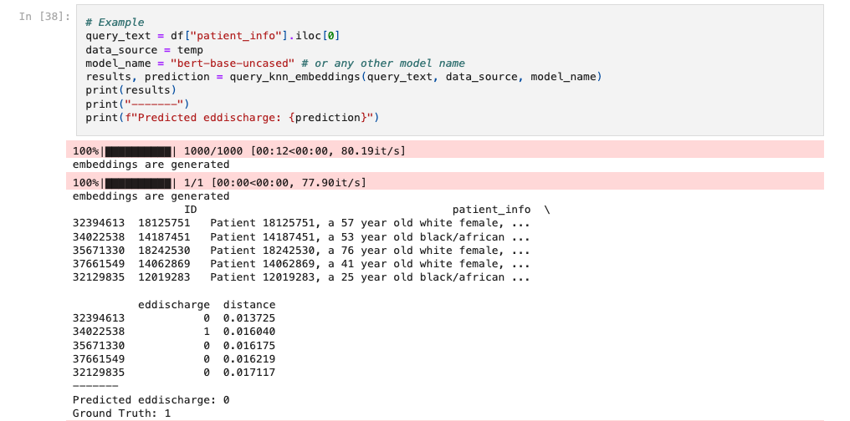
Results 2: “Evidence Based” KNN

Slide 10
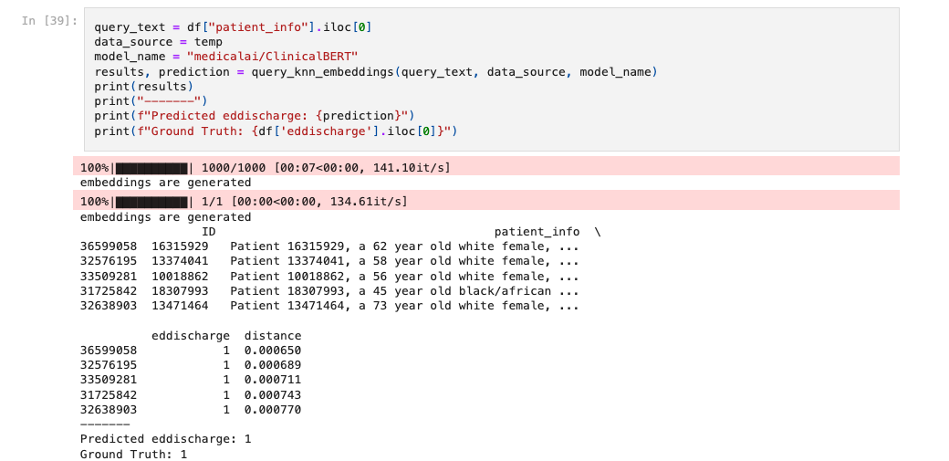
Results 2: “Evidence Based” KNN

Slide 11


Natural Discussion Questions
How can we select the following:
The number of K’s
The embedding model (BERT used in example. Exploring Llama3 embeddings currently)
The distance metric

